Slide 1
Presentation On Industrial Attachment
Software Development
Md Jewel
Roll 355536
Session 2016-17
Department Computer
Dhaka Polytechnic Institute

Slide 2

Company Profile
Naztech
Naztech is an award winning company of technology, data and business process specialists.
Application Development
Data Engineering
ERP Solution
Business Process Outsourcing

Slide 3
ERP And ERPNext
ERP : Enterprise resource planning (ERP) refers to a type of software that organizations use to manage day-to-day business activities such as Human Resource Management, accounting, project management etc.
ERPNext : ERPNext (Enterprise Resource Planning) is a full featured business management solution. It is 100% open source so we can modify as per our business Requirements.

Slide 4
Core Modules Of Erpnext
Human Resource
Stock
CRM
Buying
Selling
Project Management

Slide 5
Human Resource Management
Employee
Attendance
Payroll
Report Generate
Role Permission
Fingerprint Device Integration
Leave Management
User Management

Slide 6
Employee
Employment Type
Employee Department
Employee Grade
Employee Branch
Employee Designation
Leave Policy
Holiday List
Leave Encashment
Shift Type
Employee Health Insurance

Slide 7
Employee Profile
Image

Slide 8
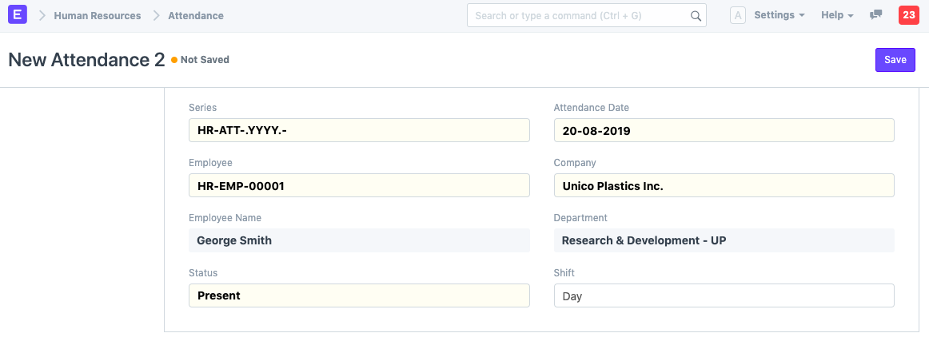
Attendance

Slide 9
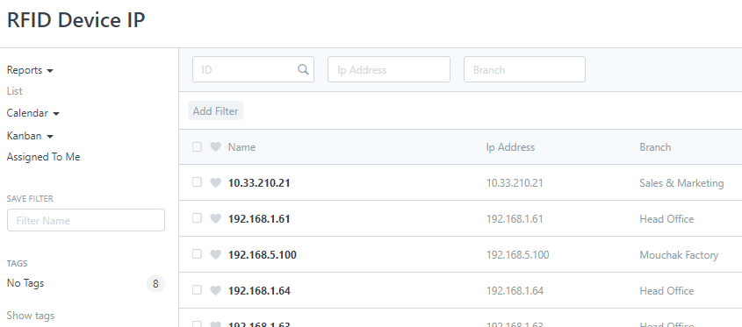
Fingerprint Device

Slide 10
Payroll
Salary Component
Salary Structure
Payroll Period
Salary Assignment
Salary Slip Generate
Additional Salary

Slide 11
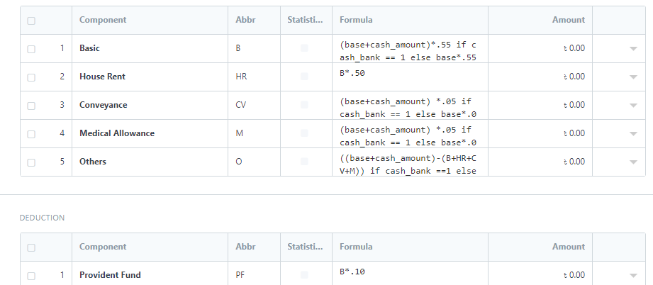
Salary Structure

Slide 12
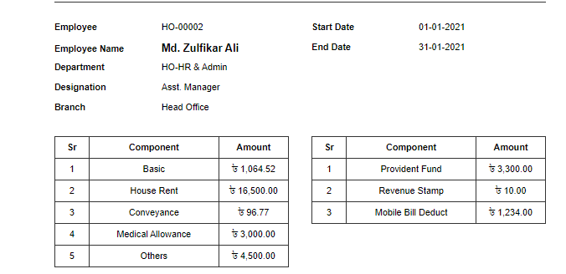
Salary Slip

Slide 13
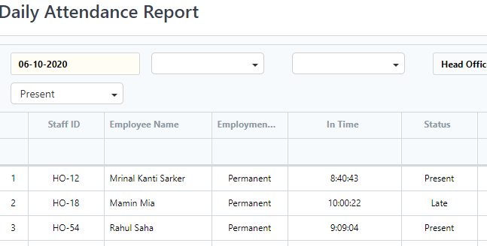
Report Generate

Slide 14
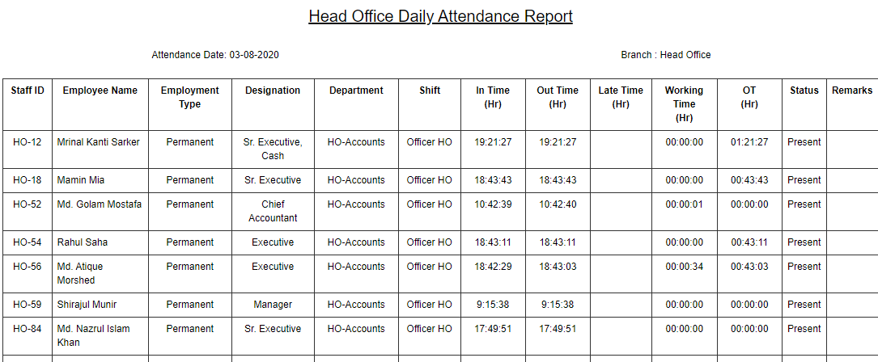
Print Report

Slide 15
Need To Customize Erpnext
Frappe Framework
Jinja Templating language
JavaScript
Python
MYSQL

Slide 16
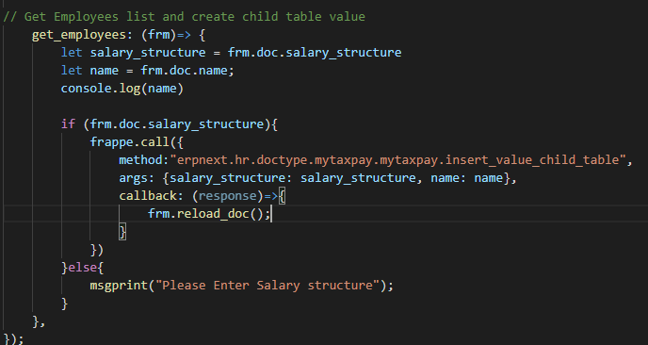
Client Side JavaScript File

Slide 17
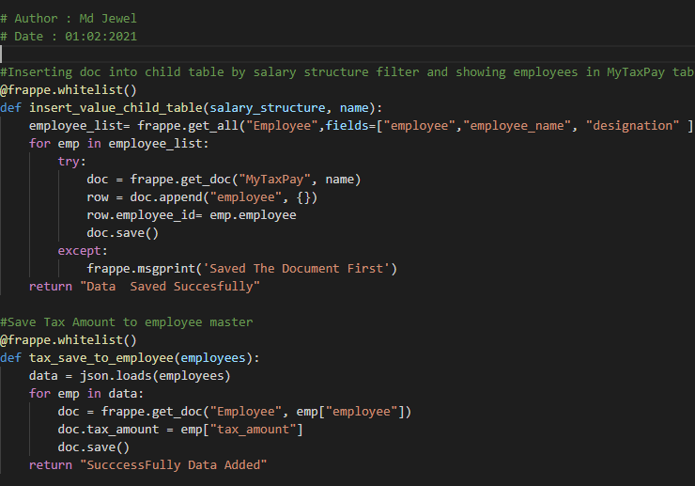
Server Side Python File

Slide 18
So What I have Learned From Industrial Attachment?
ERP Architecture
ERP System Design
ERPNext Software Customization
Advance Database Query
Frappe Framework
JavaScript
Python

Slide 19
Thank You So Much To All

